Slide 1
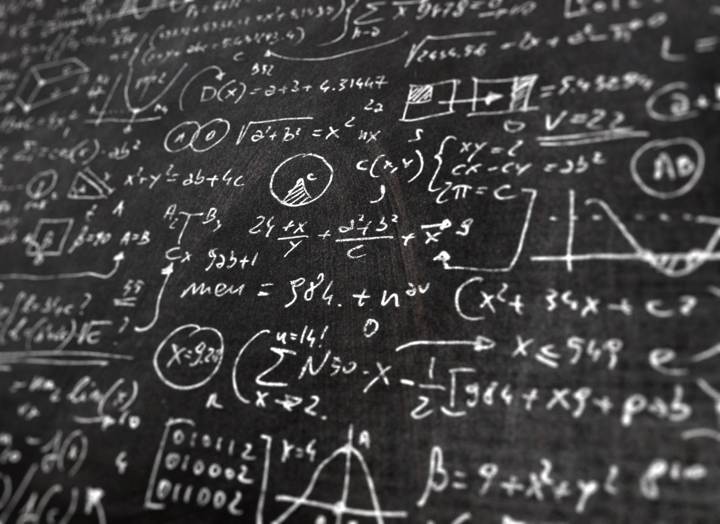
Introduction to LINQ and LINQPad
LINQPad: A tool for testing and prototyping C# code.
LINQ: Language Integrated Query for querying data in C#.

Slide 2

LinqPad - A Handy Tool for LINQ
Features:
Resembles MS SQL SSMS.
Initially uses LINQ to SQL; can later shift to Entity Framework.
Usage:
Remember to select your server name.

Slide 3
Setting Up in LINQPad 7
Load LinqPad 7.
Click "Add Connection".
Leave default settings (LINQ to SQL & LINQPad Driver).
Set Server to “.”
Specify new or existing database -> ChinookSept2018
Test connection for success.
Customize preferences (e.g., Show Line Numbers, Word Wrap, Themes).

Slide 4
Setting Up in LINQPad 7

Slide 5
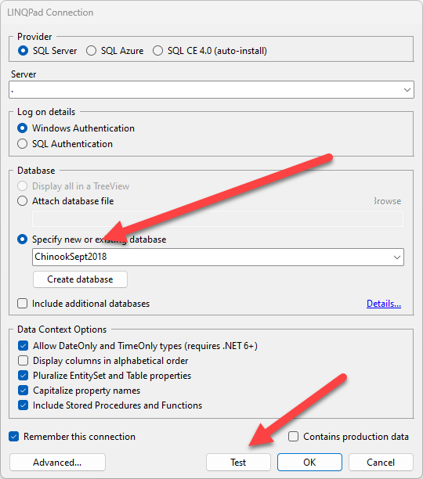
Setting Up in LINQPad 7

Slide 6

Execution Shortcuts
F5 or green triangle: Run query
Ctrl + R: Toggle results on/off
If the query seems unresponsive, use the red square to terminate

Slide 7
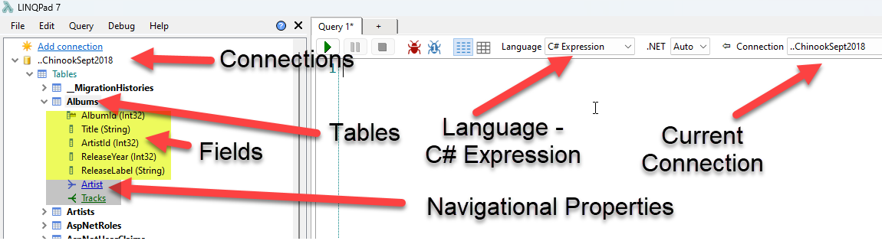
Expression IDE – C# Expression
Executes single LINQ queries without a semicolon
For multiple queries, highlight the desired one before executing

Slide 8
Commenting in LINQPad
Use // for single line comments
Ctrl+K, Ctrl+C to comment
Ctrl+K, Ctrl+U to uncomment
Ctrl+/ toggles comment on and off

Slide 9

Query vs. Method Syntax
Query Syntax:
Declarative and SQL-like.
Easier for beginners and those familiar with SQL.
Method Syntax:
More versatile with chained methods.
In line with object-oriented patterns.

Slide 10
Query Syntax vs. Method Syntax
Both can achieve the same results
Syntax preference depends on the user
Examples:
Query:
from x in Albums
select x
Method:
Albums.Select(x => x)

Slide 11
Basic Query Syntax
Used for querying datasets
Similar to SQL in structure
from a in Albums
select a
Note: Running this without “select” will produce an error.

Slide 12
Method Syntax Basics
Uses C# methods on collections
More flexible and uses lambda expressions
Example:
Albums.Select(a => a)

Slide 13

Lambda Expressions
Format: placeholder => action
Serves as a short instruction set for the method
Example:
Will return all albums from the album table
Albums.Select(a => a)
This fetches the title of each album.
Albums.Select(album => album.Title)

Slide 14
Lambda Expressions - Continue
Tracks.Sum(x => x.UnitPrice);
This is like lambdas delegates that you learned in 1571.
=> is call lambda operator. What follows is called the lambda expression.
Method is the "Sum" operator.
Items is a List<Track> Tracks {get; set;}
X is an instants of “Track".
The lambda symbol => can be read as "Do the following".

Slide 15
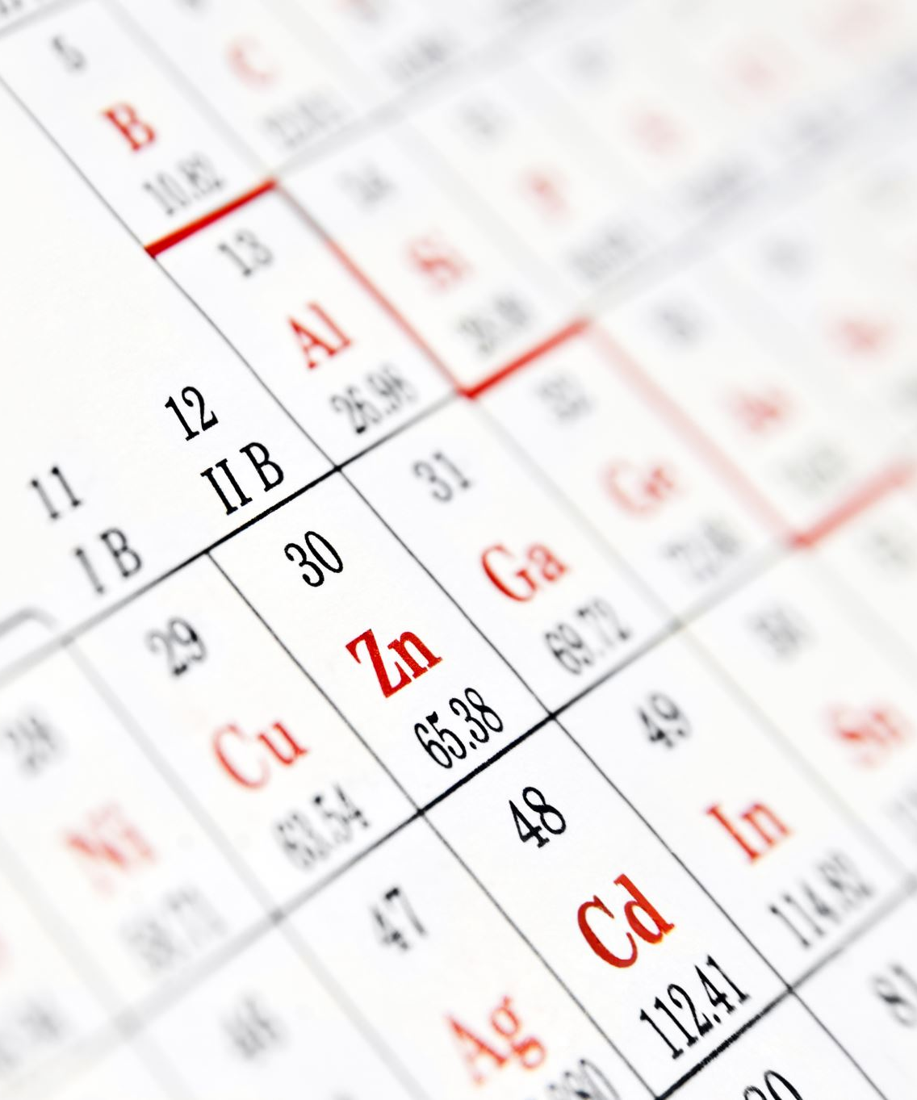
Filtering with 'Where'
A fundamental operation in data retrieval.
Filters data based on a specified condition.
The result is a subset of data that meets the criteria.
Example:
In a collection of numbers [1, 2, 3, 4, 5], we might want to filter out only the even numbers.

Slide 16

Query Syntax - Using Where
Inspired by SQL (Structured Query Language).
Provides a declarative approach.
Uses keywords (like from, where, and select).
Example:
from number in numbers
where number % 2 == 0
select number
Result: [2, 4]
Explanation:
The code iterates over each number in numbers.
It selects numbers that are divisible by 2 (even numbers).

Slide 17
Method Syntax - Overview
Uses chained method calls.
More in line with object-oriented programming patterns.
Works with lambda expressions.
Example:
numbers.Where(number => number % 2 == 0)
Explanation:
The Where method is called on the numbers collection.
The lambda expression number => number % 2 == 0 is the filtering condition.

Slide 18

Lambda Expressions Deep Dive
A concise way to write anonymous methods.
Format: (input parameters) => expression
Example:
In number => number % 2 == 0:
number is the input parameter.
number % 2 == 0 is the expression that checks for even numbers.

Slide 19

Practical Example: Filtering Books
Given a collection of books, how can we find books published after the year 2000?
Query Syntax:
from book in books
where book.Year > 2000
select book.Title
Method Syntax:
books.Where(book => book.Year > 2000).Select(book => book.Title)

Slide 20

Conclusion
The Where clause is a powerful tool in LINQ to filter data.
Both Query and Method syntaxes provide the ability to use the Where clause, but they offer different ways to express the same operation.
It's beneficial to understand both to utilize LINQ effectively.

Slide 21

Statement Regarding Slide Accuracy and Potential Revisions
Please note that the content of these PowerPoint slides is accurate to the best of my knowledge at the time of presentation. However, as new research and developments emerge, or to enhance the learning experience, these slides may be subject to updates or revisions in the future. I encourage you to stay engaged with the course materials and any announcements for the most current information

